Slide 1


Zensar DBA Shared Support Service Monthly Report – June- 2025

Slide 2
Table of Content
Monthly Highlights – June -2025
Tasks Analysis – June -2025
Upcoming Activities – Next Months
Risks/Issues and Mitigations

Slide 3
Monthly Highlights EBS – June 2025
Oracle Recommendations:
Creating Notifications topics and subscriptions for OCI announcements.

Slide 4
Monthly Highlights EBS – June 2025
Highlights
DEV Refresh completed successfully.
UAT in EBS URL changed from .com to .net completed successfully and Logo, sign issue resolved.
DEV .com to .net change in URL - reverted back.

Slide 5
Monthly Highlights EBS – June 2025
List of open Issues :
Alerts are not receiving to DL from OCI Prod – Non-prod server.

Slide 6
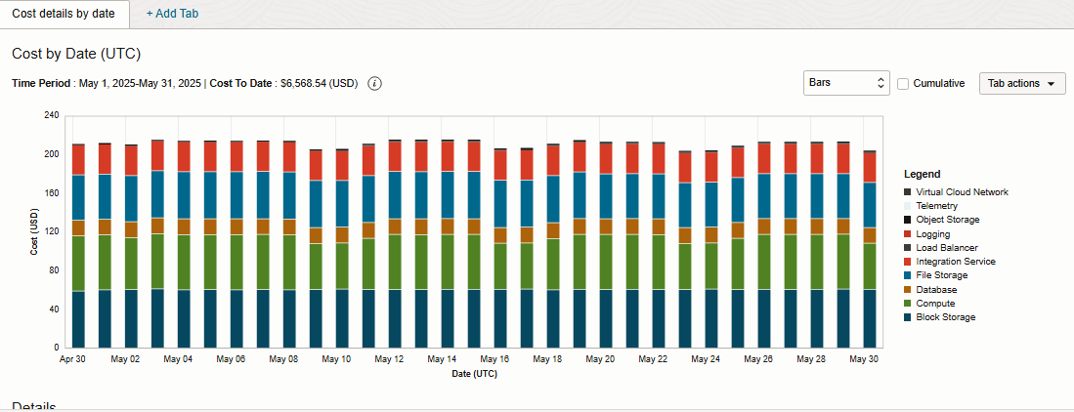
Monthly Highlights EBS – June 2025

Slide 7
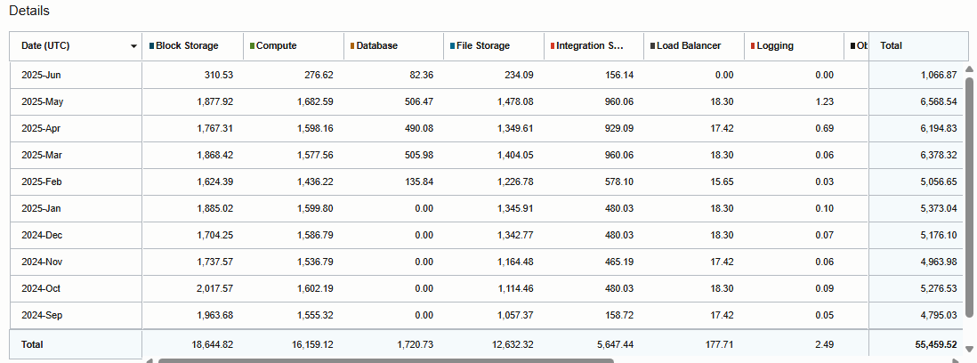
Monthly Highlights EBS – June -2025
Monthly Cloud Billing : June 2025

Slide 8
Summary - Task Analysis
Zensar team successfully closed and concluded running tasks

Slide 9
Upcoming EBS Activities – Next Month
Planned Key Activities
11i DB - 19c cloud migration
ECC Configuration on DEV/UAT.
Oracle Application upgradation from R12.2.10 to R12.2.14
SSL implementation for SSO Setup

Slide 10
Highlights SQL Server – June 2025
Essential Activities
Zensar Team have removed unwanted temp table from Salesforce databases which was created after reran jobs.
Taking care of weekly maintenance for DEV , Production and reporting environments.
Monitoring & Troubleshooting failed SSIS packages.
Restore table on PROD01 server with recent backup to resolve table Data mismatch issue.
Zensar Team has worked on Database and Table Growth Report for May’25 and shared with OMNI team.
Monitoring & Troubleshooting Subscription failures.
Team have deployed Power BI health check dashboard.
OMNI Team provided new Opera Cloud KT to Zensar Team and Zensar Team also shared understanding documents.

Slide 11
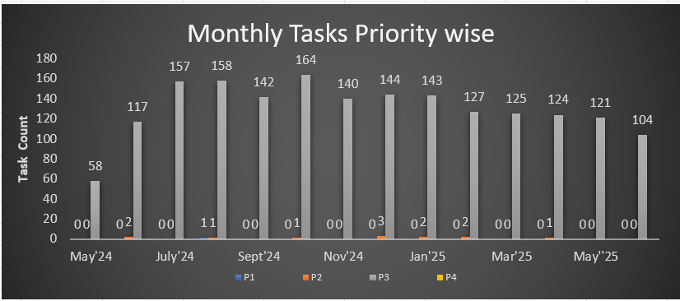
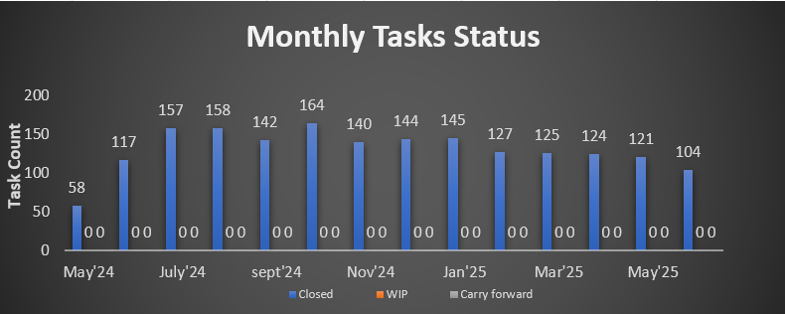
Summary - Task Analysis MS SQL Server
Zensar team successfully closed and concluded running tasks

Slide 12
Upcoming MSSQL Activities – Next Month
Planned Key Activities
Omni MSSQL – SQL Server Environment.
- Planned to create Database and Table Growth report in Power BI.
- Going to set process for Refresh/Restore Databases.
- Exploring OPERA Cloud.

Slide 13


